Slide 1
How Archivists Could Stop Deepfakes From Rewriting History
Melanie Ehrenkranz
Freelance/Gizmodo

Slide 2
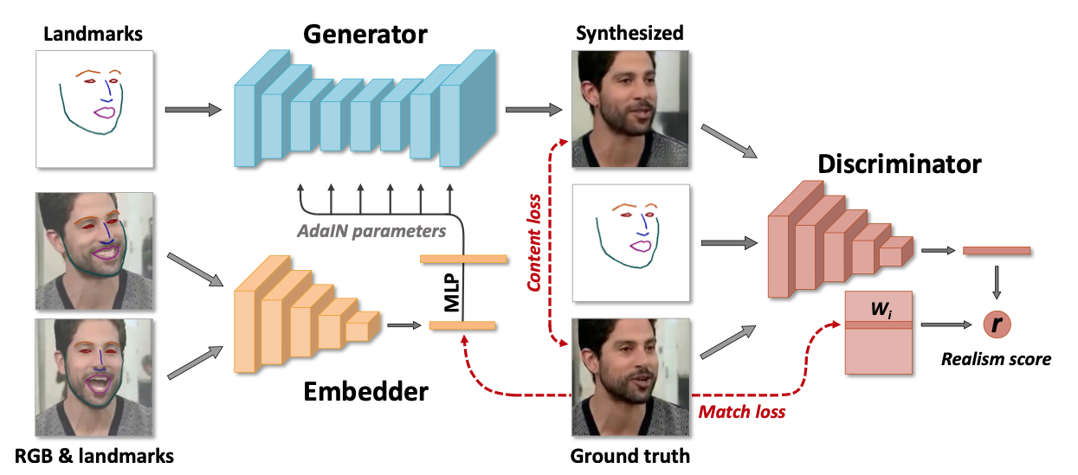
GAN-based Deepfakes – DeepFaceLab
Zakharov et al. “Few-Shot Adversarial Learning of Realistic Neural Talking Head Models” – fig. 2

Slide 3
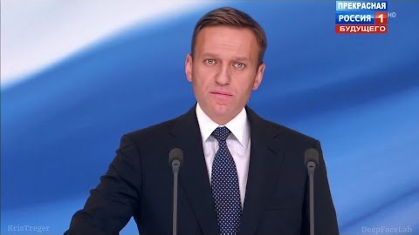
DeepFaceLab Creates Realistic Face Swaps
https://www.youtube.com/watch?v=xr5FHd0AdlQ

Slide 4
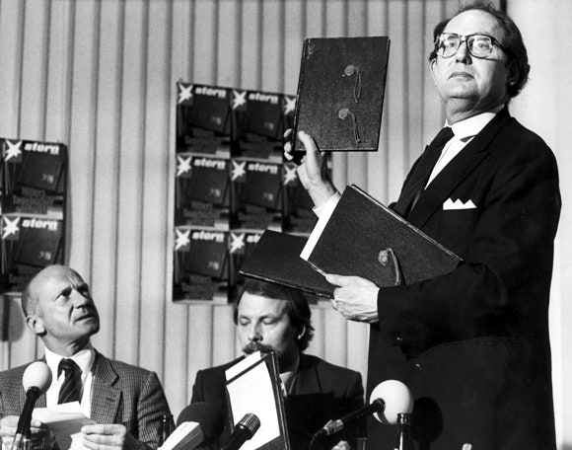
Hitler Diaries
April 25, 1983
Stern magazine (Germany)
Initially authenticated as genuine by Oxford historian Hugh Trevor-Roper and forensics investigators at the German Federal Archives (Bundesarchiv)
Further study by the Bundesarchiv showed fluorescent reaction to UV light and polyester bindings which were not contemporaneous to the diaries; purported origins
https://www.newyorker.com/books/page-turner/diary-of-the-hitler-diary-hoax

Slide 5
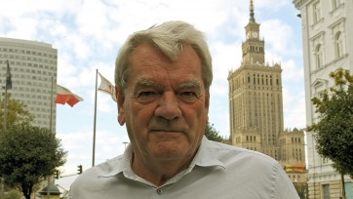
“Hitler Diaries’” Sinister Implications
Holocaust Denial
David Irving
Entries in the diaries contained no reference to the holocaust
Used by holocaust denier David Irving to support his thesis (from his book Hitler’s War) that Hitler was unaware that the holocaust was happening
Eventually his views on the holocaust would grow to outright denial
Irving initially questioned the authenticity of the Hitler Diaries until it became apparent that they supported his Hitler’s War thesis
https://www.splcenter.org/sites/default/files/styles/splc_medium_rectangle/public/extremist_profile_images/SPLC-Extremist-Files-David-Irving-1280x720.jpg?itok=UxBejMfN&timestamp=1438134693

Slide 6
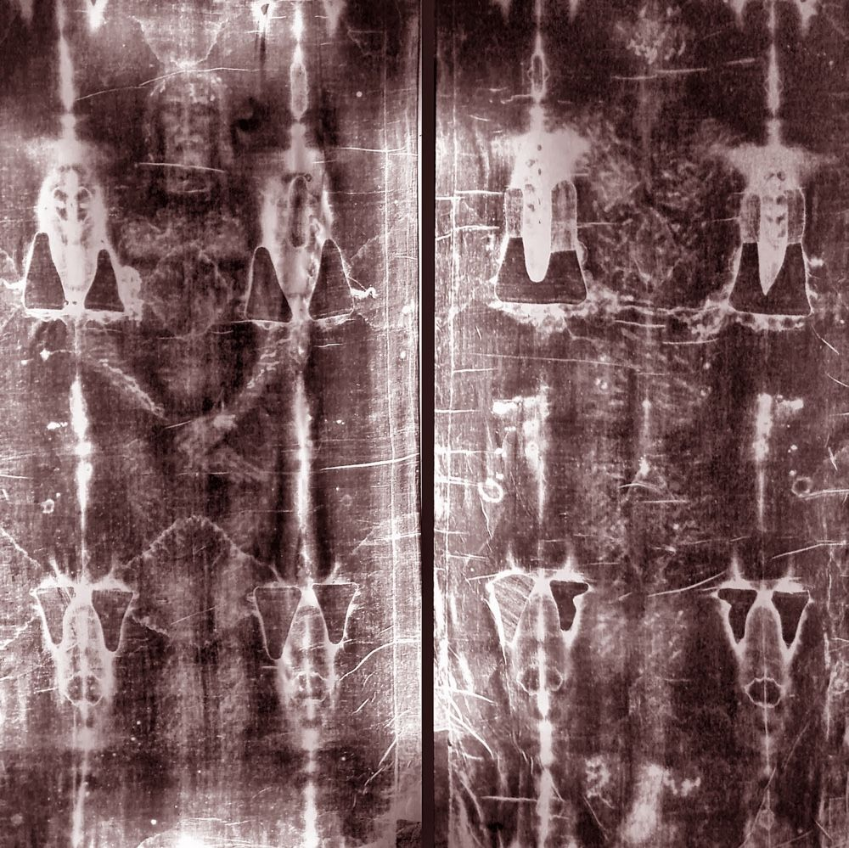
Archives Have Always Had a Problem With Fakes - The Shroud of Turin
Unknown creation date or method
First historical record
1390 memorandum to Pope Clement VII from Bishop Pierre d'Arcis declaring that the Shroud’s artist confessed to it being a forgery
The Shroud passed hands in various caretaker houses until being held at Turin Cathedral starting in 1578
The Vatican has never passed official judgement on the Shroud’s authenticity
“In the Church's view, whether the cloth is authentic or not has no bearing whatsoever on the validity of what Jesus taught or on the saving power of his death and resurrection.” OSV's encyclopedia of Catholic history

Slide 7
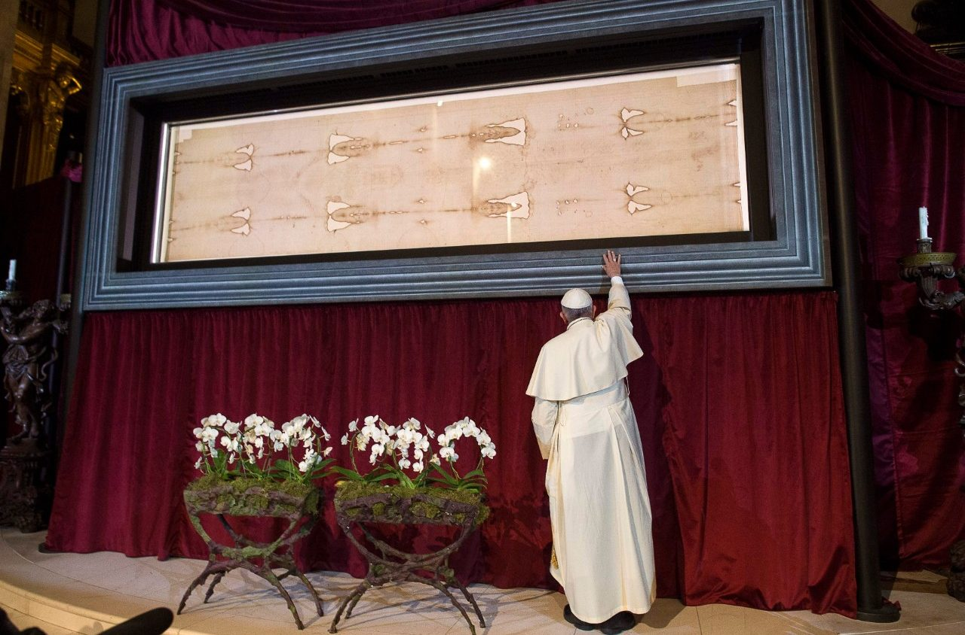
Sindonology
Turin Commission
1969
11 members (5 Scientists)
Radiocarbon dating
1260-1390
Refuted by medieval repair, biocontamination, and CO hypotheses
The authenticity of the Shroud is hotly debated
Bias – religious belief
Method of creation
No known process to create the Shroud is known for the time it was created
Authentication (or lack thereof) by authorities
https://www.vaticannews.va/en/church/news/2019-12/turin-shroud-public-display-2020-taize.html

Slide 8
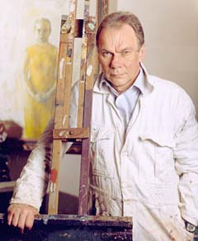
Explicit Attacks on Archives
Tate Gallery
September 1995
Collusion between art forger John Myatt and ”broker” John Drewe.
Drewe gained access to several art archives, including the Tate Gallery and forged provenance for multiple fakes.
Methods included editing documents in archives to add faked paintings to past art shows and receipts of sale.
The attacker was a trusted insider.
Forgeries were successful because they exploited all three characteristics of forgery acceptance
Bias – Modern art was at the height of commoditization and media exposure.
Method of creation – Myatt put effort into emulating the materials and methods of the original artists.
Authentication by authorities – Drewe entered forged documents into the archives to provide support for the forged art.
https://archive.nytimes.com/www.nytimes.com/library/magazine/home/19990718mag-art-forger.html

Slide 9
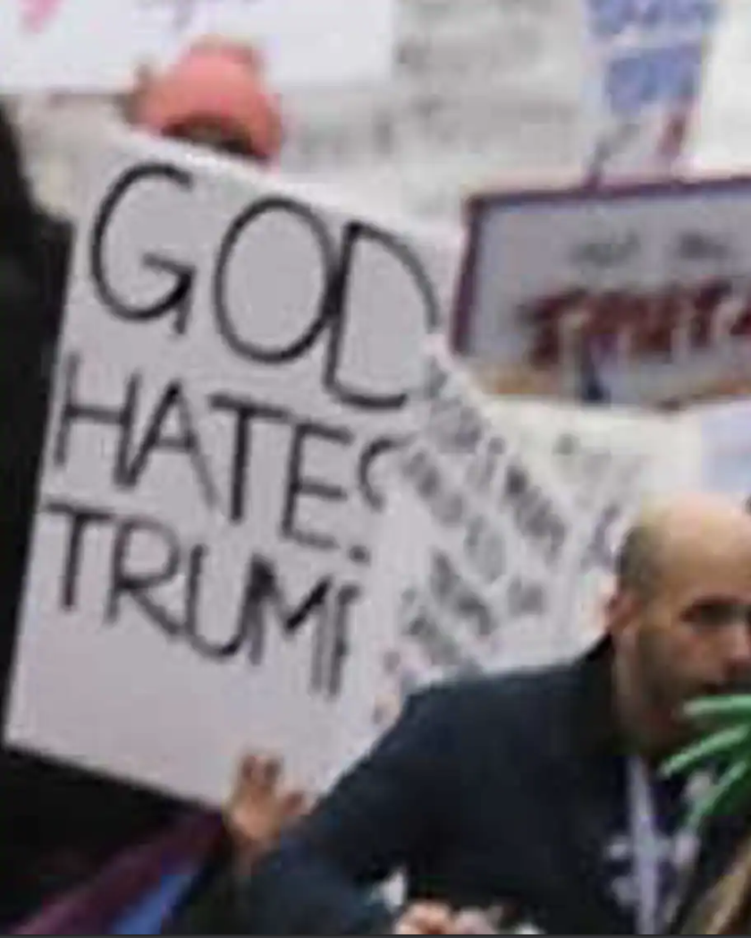
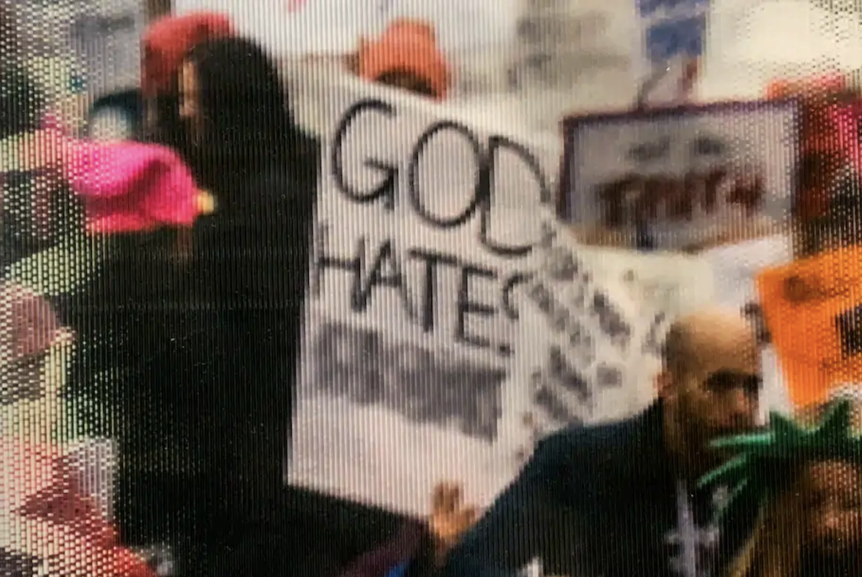
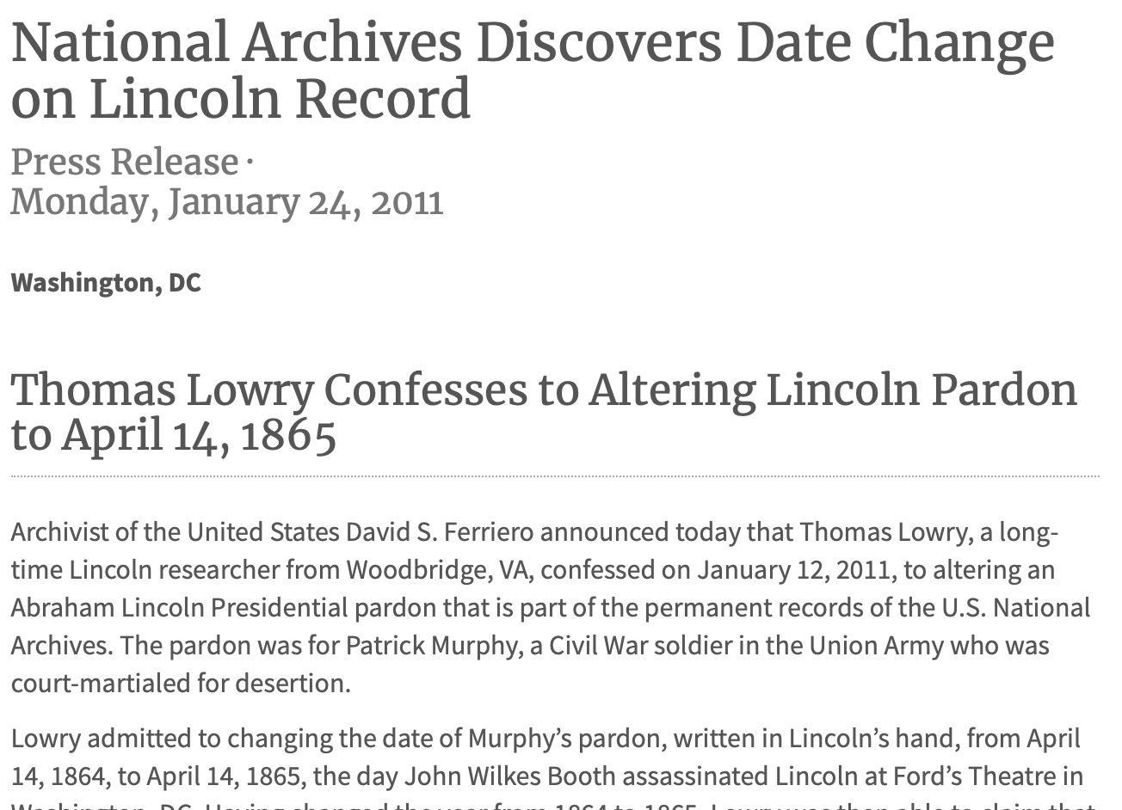
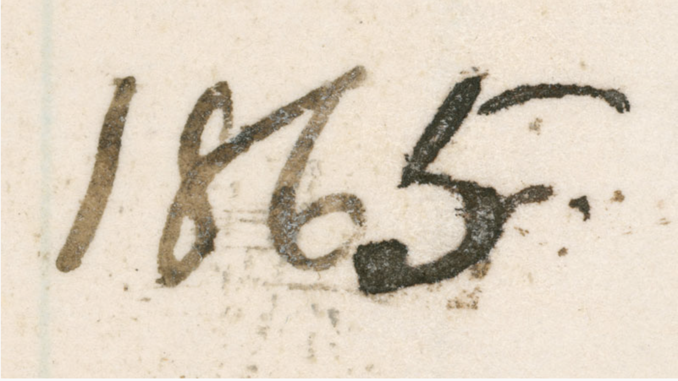
The Hardest Part is Getting In
The authenticating authority is the weakest part of the killchain.
Deepfakes, even when archived in context of being fake are still a record.
Metadata becomes the new target.
There’s no evidence that metadata can be easily corrupted by external actors, but trusted ones are fallable and squishy.
https://www.cnn.com/2020/01/19/opinions/national-archives-womens-march-history-corruption-perry/index.html
https://www.archives.gov/press/press-releases/2011/nr11-57.html

Slide 10
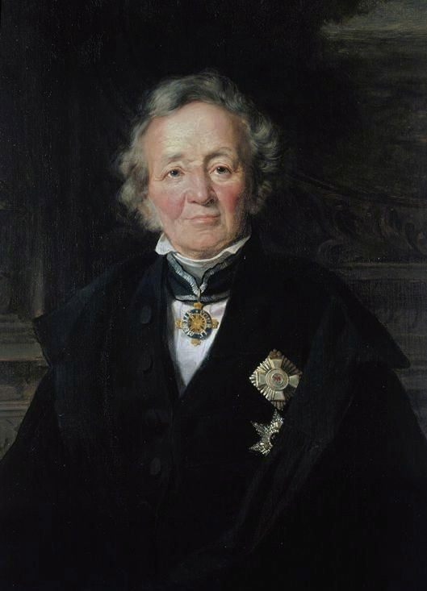
Should Deepfakes be Archived?
Should ”our collective memory” include deliberately false memories?
Archived Deepfakes can provide examples of “method of creation.”
ISO 15489 on Authenticity and Reliability
An authentic record is one that can be proven to:
a) be what it purports to be;
b) have been created or sent by the agent purported to have created or sent it; and
c) have been created or sent when purported.
A reliable record is one:
a) whose contents can be trusted as a full and accurate representation of the transactions, activities or facts to which they attest; and
b) which can be depended upon in the course of subsequent transactions or activities.
“The record should just state how it really happened.” - Leopold von Ranke
https://en.wikipedia.org/wiki/Leopold_von_Ranke#/media/File:Jebens,_Adolf_-_Leopold_von_Ranke_(detail)_-_1875.jpg

Slide 11
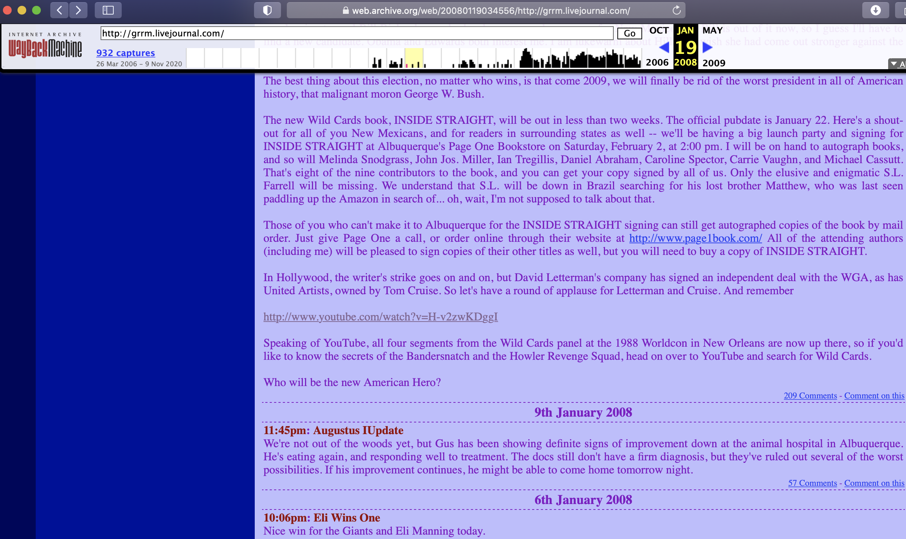
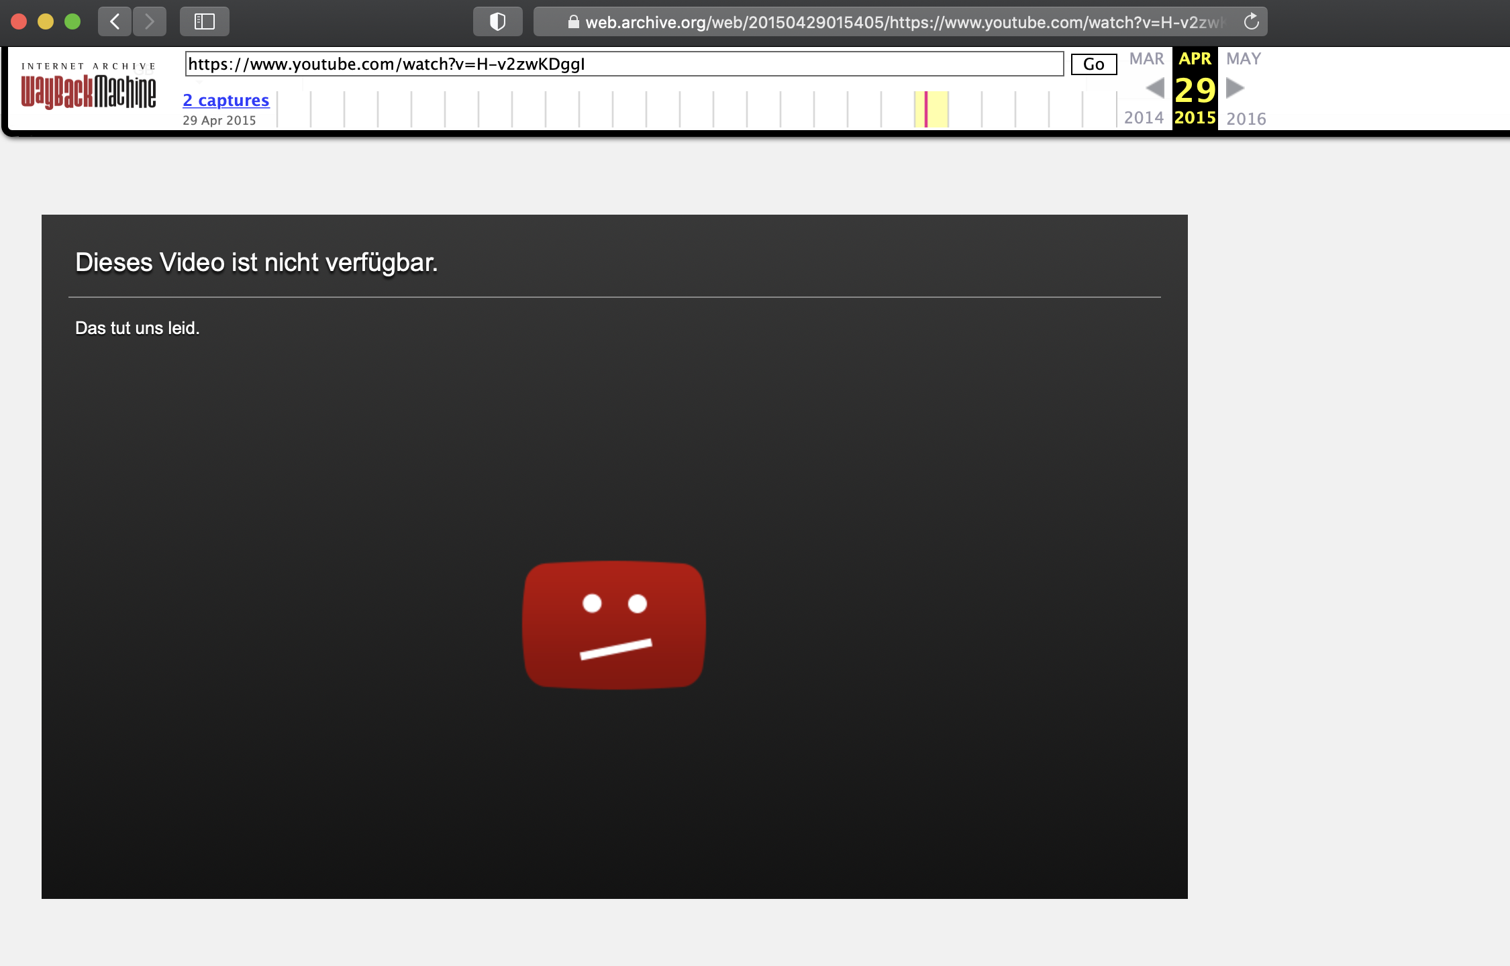
Web Archives are Lacking in Reliability and Useability
Jan 19, 2008
Apr 29, 2015
In German?
https://ws-dl.blogspot.com/2019/03/2019-03-18-cookie-violations-cause.html

Slide 12
Specific Events Don’t Really Matter
Firehose of Falsehood
People are more likely to believe a story when it appears to have been reported by multiple sources.
People are also more likely to believe a story when they think many others believe it, especially if those others belong to a group with which they identify.
Bots
"Don't expect to counter the firehose of falsehood with the squirt gun of truth.”
Here, the “squirt gun of truth” is archival record of media being manipulated.
Unreliable replay and sparse crawls provide opportunities for Deepfakes that can’t be debunked via archived media (because there isn’t any).
The context doesn’t matter. It’s more water for the Firehose.

Slide 13
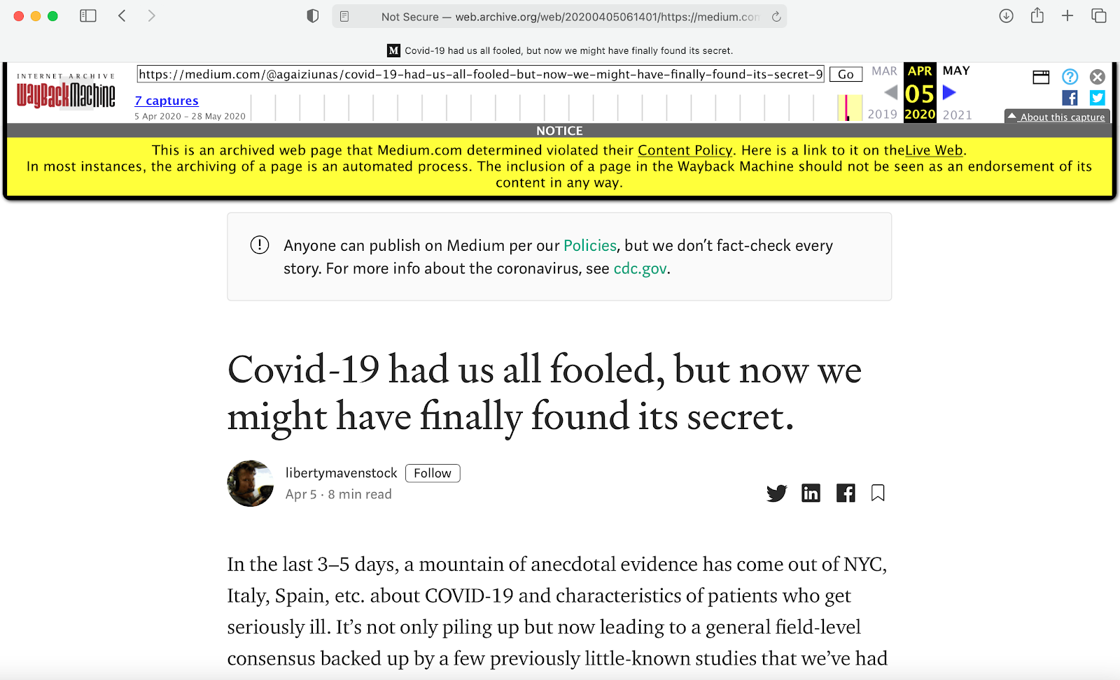
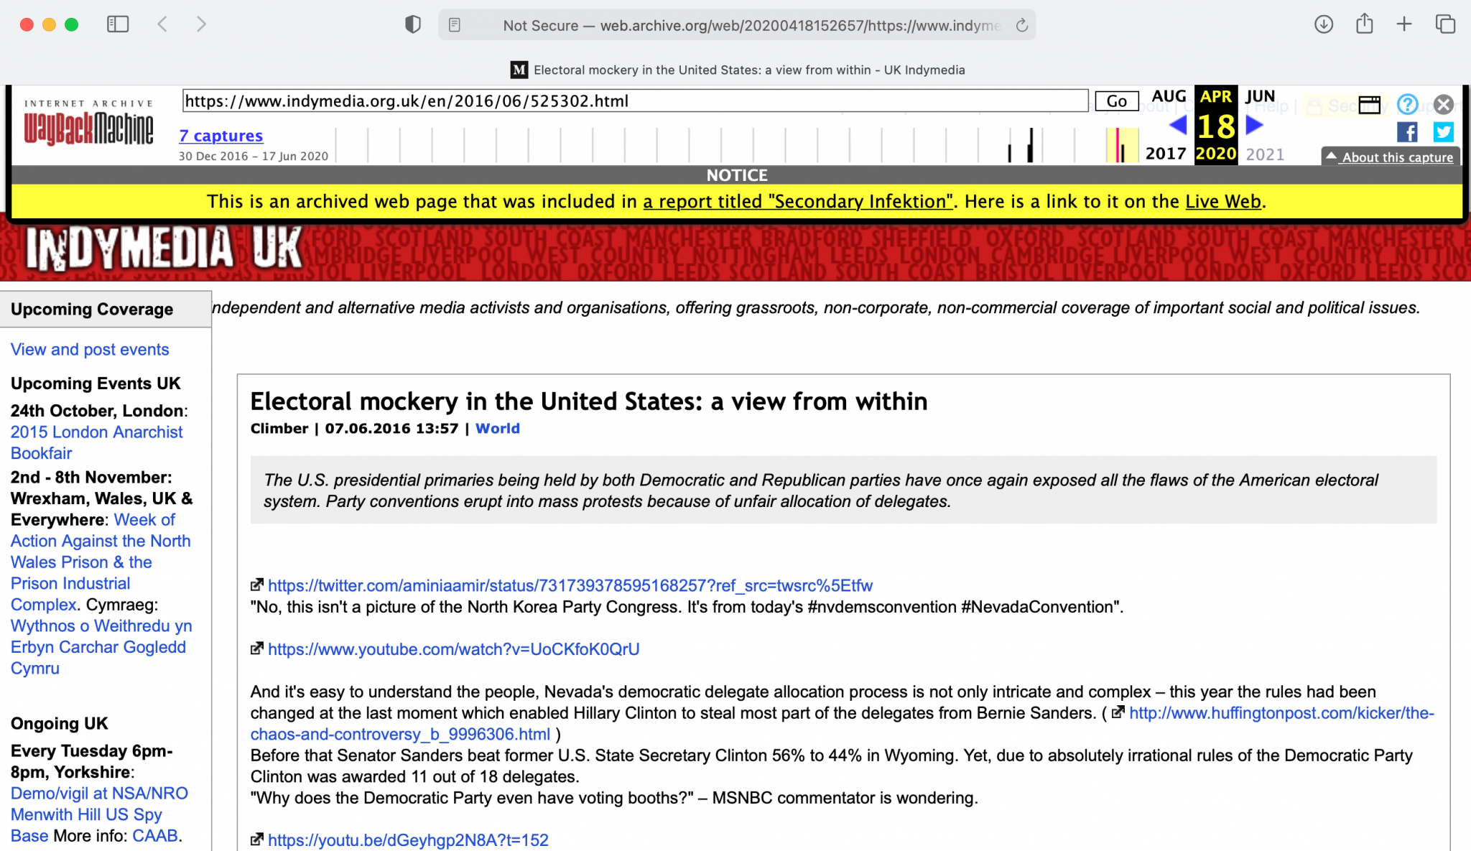
Squirt Gun of Truth vs. Duty of Care
RAND’s advice on countering the Firehose of Falsehood model includes not focusing on refutation of the false information but presenting the truth with the following caveats:
(1) warnings at the time of initial exposure to misinformation
(2) repetition of the retraction or refutation
(3) corrections that provide an alternative story to help fill the resulting gap in understanding when false “facts” are removed.
Archivists have a duty to not only retain information but present it within context that is trusted as a full and accurate representation of the transactions, activities or facts to which they attest – ISO 15489
http://blog.archive.org/2020/10/30/fact-checks-and-context-for-wayback-machine-pages/

Slide 14
Data Redundancy as Protection
Forcing an attacker to infiltrate and change records/metadata in the majority of redundant archives.
A LOCKSS-like system for web archives.
Web archives would have to standardize both crawling and replay.
A homogeneous fault-tolerant system for a single archive would be expensive w.r.t. storage.

Slide 15
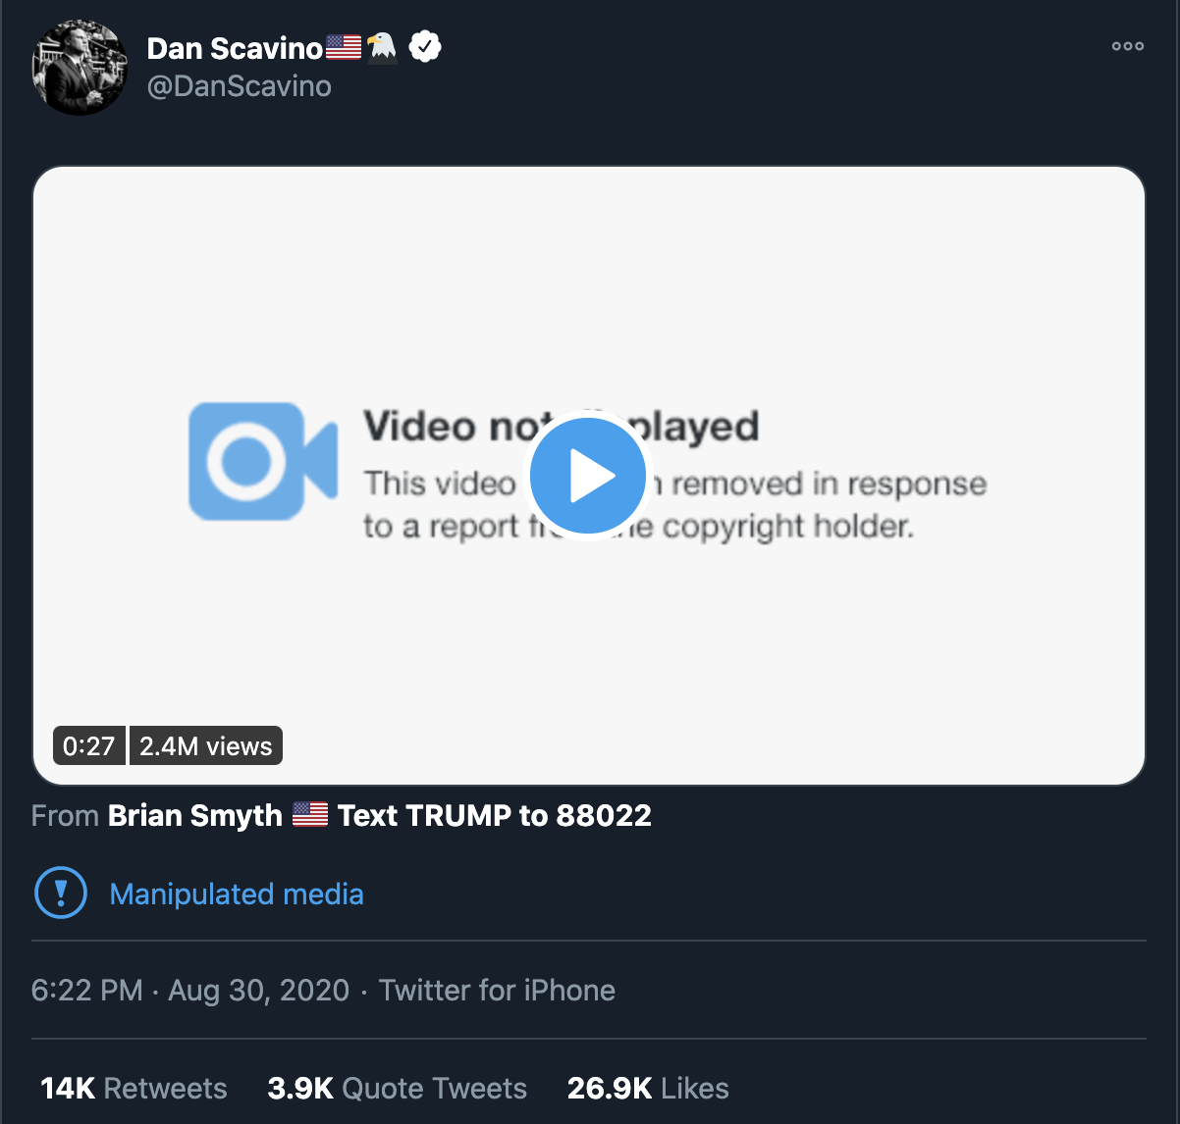
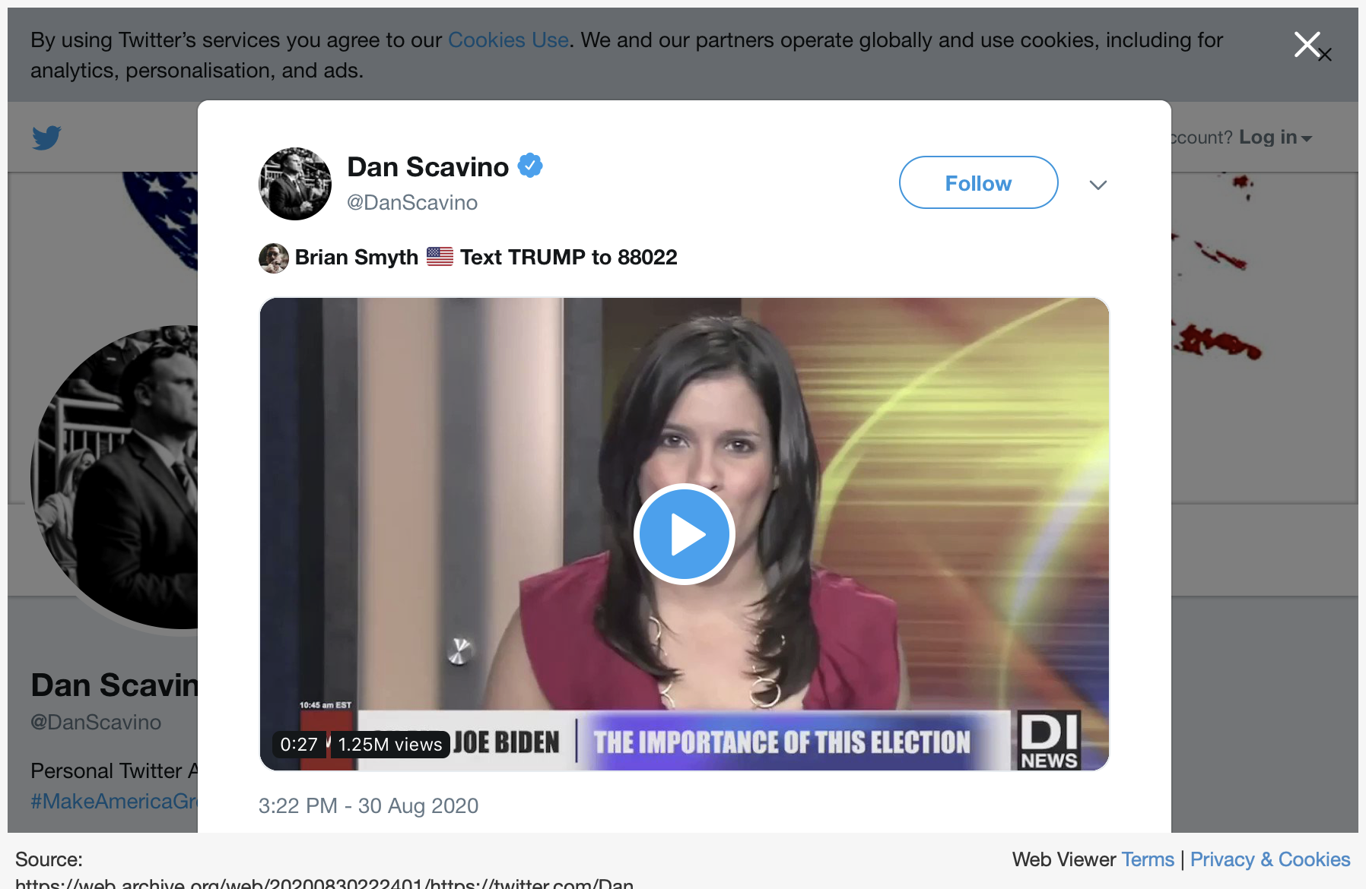
Deepfakes are Just a Medium. The Danger is Bias
https://twitter.com/DanScavino/status/1300197309641355264

Slide 16
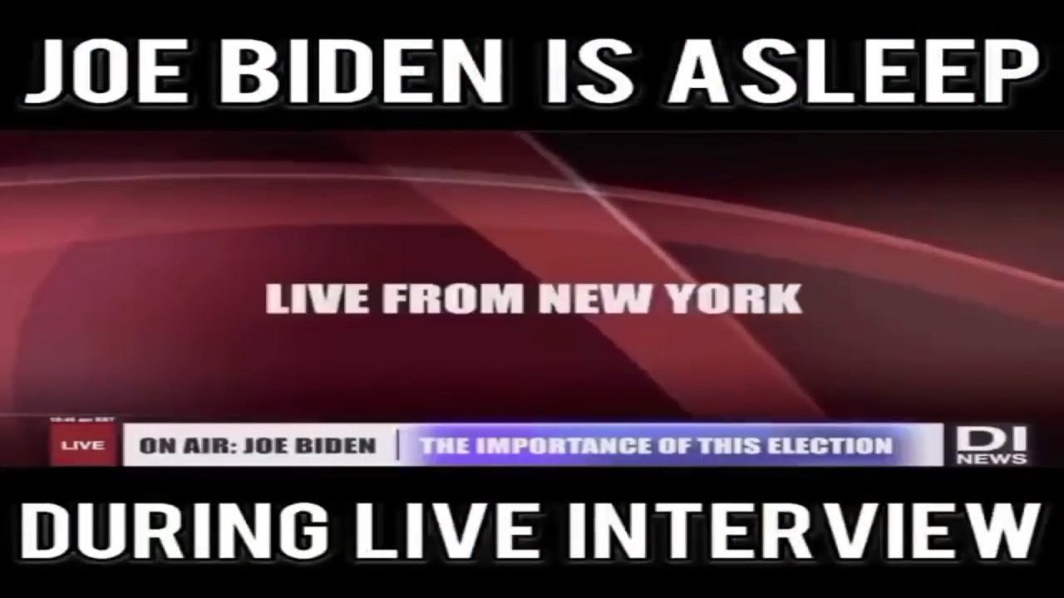
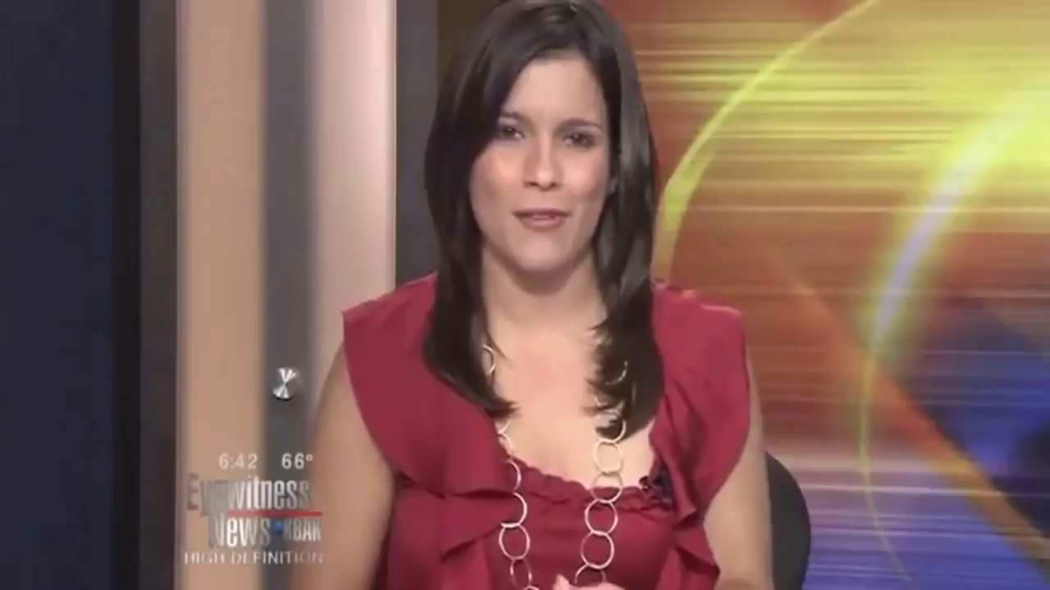
”Shallow”fakes are Just as Effective
https://www.youtube.com/watch?v=81z9AY3FNOk&t=13s
Fake
Source

Slide 17
How Can Archivists Stop Deepfakes from Rewriting History?
Maintain trusted authority on determining the authenticity of records.
Provide clearly evidenced context for how the Deepfake is fake.
Verifiable provenance of the metadata describing the Deepfakes.
Provide data and resources to recreate the Deepfake to prove method of creation.
Hardware emulation for system it was created on
Trained model
Original dataset and code to train the model
Data used to create the Deepfake from the trained model

Slide 18
Conclusion
Bias is what drives people to consider accepting fake media.
The method of creation is instrumental evidence in verifying the authenticity of media.
Authentication by authorities provides trust in the determination.
The danger of erroneously accepting or presenting fake media can be mitigated as long as archivists can address these three things when archiving data.

